Slide 1
Dependent Care Flexible Spending Account
Qualified Expenses
Stretch your paycheck to help cover dependent care expenses.
Enjoy pre-tax savings on qualified dependent expenses with a Dependent Care Flexible Spending Account.
A Dependent Care Flexible Spending Account (DC-FSA) covers qualified care expenses for children age 12 and under and eligible older dependents who cannot care for themselves.¹ The IRS determines which expenses are qualified for reimbursement. Examples of qualified expenses include the following:
Dependent Care FSA-qualified expenses include:
Licensed nursery schools
Qualified childcare centers
Au pair or nanny
Before- and after-school programs
Summer camps
Sick childcare
Preschool tuition
Adult day care facilities
Elder care
Adult day care
While this list identifies the eligibility of some of the most common dependent care expenses, this list is not meant to be all-inclusive.
For a complete list of qualified dependent care expenses, see IRS Publication 503.²
These expenses are typically not qualified for reimbursement under your DC-FSA
Babysitting (non work-related)
Dance lessons
Piano lessons
Language lessons
Kindergarten tuition
Field trips
Late payment fees for childcare
Sleepaway summer camps
Meals, food or snacks for children
Medical care for children or dependent adults
Household services (cook, cleaning, maid)
Nursing home care
Private school tuition
Tutoring, educational and learning skills
These expenses are typically not qualified for reimbursement
under your DC-FSA

Slide 2
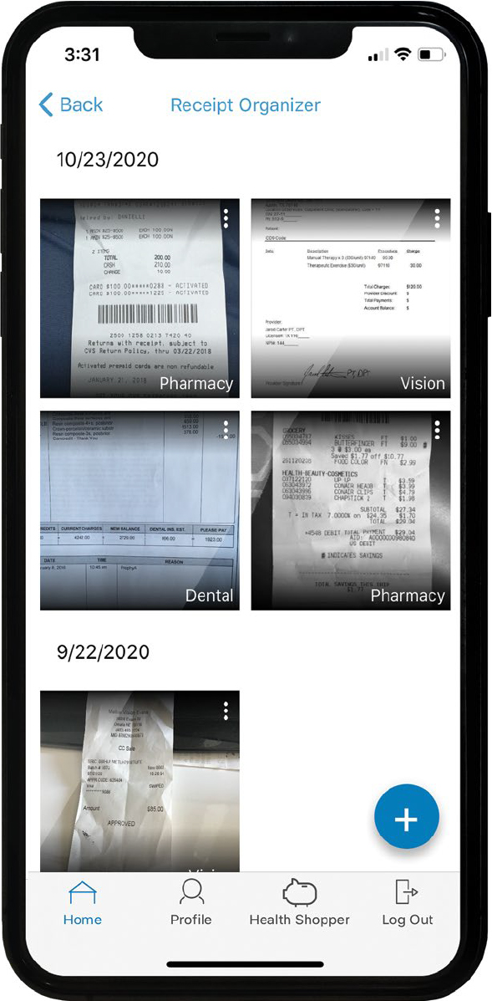
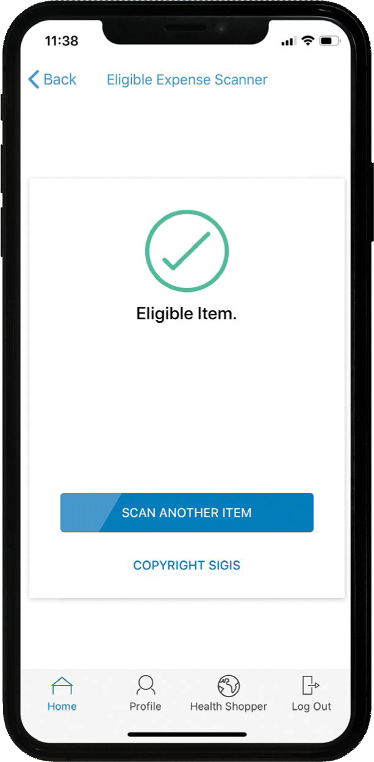
Dependent Care Flexible Spending Account (DC-FSA)
Receipt Organizer
Use the receipt organizer on the MetLife HS&SA mobile app to store receipts and other supporting documentation related to your DC-FSA. The IRS requires documentation for reimbursements from your account, and the Receipt Organizer makes using your account easy!
Manage your account on the go! To download, search MetLife HS&SA on the Apple or Android App Store on your mobile device.
This app is designed for your Apple device (including iPhone, iPad, and iPod touch) version 6.0 and higher or Android device, version 2.2 or higher.
iPhone, iPad, iPod touch, iOS, and Apple App Store are registered trademarks of Apple Inc. All other trademarks and service marks are the property of their respective owners.
Important Note
Payment from a DC-FSA cannot be made until after the service has been provided and after contributions have been posted to your account.
For example, if you pay your childcare provider for the entire month of January on January 1, you cannot be reimbursed until after January 31.
Questions?
Contact Customer Service at (833) 571-0500 Monday-Friday, 8 am-8 pm ET
https://HealthSavingsAndSpending.MetLife.com
Eligible dependents include any child (age 12 and under) who resides with a participant and for whom the participant is entitled to a personal tax exemption as a dependent and a spouse, parents, or other tax-dependent adults who reside with the participant and who are physically or mentally incapable of self-care.
In addition, there may be legislation or additional publications that may modify or expand available qualified expenses. Employees should refer to their employer’s plan document(s) for the latest list of qualified expenses under their plan.
Like most group benefit programs, benefit programs offered by MetLife and its affiliates contain certain exclusions, exceptions, waiting periods, reductions of benefits, limitations and terms for keeping them in force. Nothing in these materials is intended to be, nor should be construed as, advice or a recommendation for a particular situation or individual. Participants should consult with their own advisors for such advice. Federal and state laws and regulations are subject to change.
MetLife Consumer Services | 200 Park Avenue | New York, NY 10166
L0821016056[exp0823][All States][DC,GU,MP,PR,VI] © 2022 MetLife Services and Solutions, LLC

